Slide 1
RAJALAKSHMI ENGINEERING COLLEGE
Department of Artificial Intelligence and Data Science
IT19541 WEB TECHNOLOGY
MINI PROJECT
Smart Travel Hub: A Unified Trip Planning & Booking Platform
Project by,
LAVANYA S(221801028)
MONISHA M(221801034)
Date Slide Number

Slide 2
OUTLINE
Objectives
Abstract
Introduction to Problem Domain
Existing system
Limitation of the Existing System
Proposed system
Architectural design for Proposed system
Algorithm/Technique Used
Module Description
Results and Discussions
References
Date 25-03-2025 Slide Number 01

Slide 3
OBJECTIVE
To develop a seamless travel platform using HTML, CSS, JavaScript, and PHP that simplifies trip planning and booking.
To build a secure, user-friendly travel booking platform that enables users to plan trips easily and allows admins to manage travel services efficiently.
Date 25-03-2025 Slide Number 02

Slide 4
ABSTRACT
This project aims to develop a web-based travel planning and booking platform using PHP, MySQL, HTML, CSS, and Bootstrap. The system enables users to easily browse and book flights, hotels, and activities through a user-friendly interface. It provides a secure login and registration system with role-based access, allowing normal users to make bookings and administrators to manage travel services. The platform ensures efficient storage and retrieval of user data, bookings, and service information through a structured database. By combining a responsive design with robust backend functionality, the system seeks to simplify travel management and enhance the overall booking experience for users and administrators.
Date 25-03-2025 Slide Number 03

Slide 5
INTRODUCTION TO PROBLEM DOMAIN
In today’s fast-paced world, travelers seek a simple and reliable platform to plan and book their trips efficiently.
However, many existing systems are either too complex, fragmented, or lack real-time management capabilities for travel services.
Users face challenges like scattered information, complicated booking procedures, and poor user interfaces.
Administrators also struggle with managing travel services manually or through outdated systems.
There is a growing need for an integrated platform that provides an easy-to-use interface for users and an efficient management system for administrators to handle flights, hotels, and activities all in one place.
Date 25-03-2025 Slide Number 04

Slide 6
EXISTING SYSTEM
Sr. No | Author(s) | Year | Technique | Description | Outcome
1. | John Smith, Emily Brown | 2020 | Rule-Based Recommendation | Travel platforms use predefined rules to suggest flights and hotels based on location and price. | Provides limited personalization and lacks flexibility in dynamic travel preferences.
2. | Michael Johnson, Sophia Lee | 2021 | Machine Learning | AI-driven travel recommendations based on user behavior, preferences, and previous bookings. | Improves personalization but requires extensive data collection and user profiling.
3. | David Miller, Olivia Taylor | 2019 | API-Based Integration | Platforms use multiple APIs to fetch real-time booking details for flights, hotels, and attractions. | Ensures dynamic updates but can lead to inconsistencies between different platforms
4. | Daniel Wilson, Emma Davis | 2022 | Crowdsourced Reviews | Travel platforms rely on user-generated reviews and ratings to rank hotels and experiences | Helps users make informed decisions but is prone to biased or fake reviews.
5. | James Anderson, Lily Martinez | 2023 | Blockchain for Secure Transactions | Secure payment processing using decentralized technology for travel bookings. | Enhances security but increases transaction complexity and processing time.
Date Slide Number
Notes:
6

Slide 7
LIMITATIONS OF EXISTING SYSTEM
Sr. No | Limitation
1. | Travel details (flights, hotels, attractions) are scattered across multiple websites, making planning difficult.
2. | Existing platforms do not provide tailored recommendations based on user preferences and travel history.
3. | Users do not receive instant alerts for flight delays, price changes, or local events, leading to inconvenience.
4. | Overloaded choices and inconsistent UI designs make it confusing for travelers to compare and book options.
5. | Most platforms focus on either flights or hotels but do not provide an all-in-one travel solution.
Date 25-03-2025 Slide Number 06

Slide 8
PROPOSED SYSTEM
Web-based platform for travel planning and booking.
User registration and login with role-based access.
Normal users can browse and book flights, hotels, activities.
Admins can manage (add/edit/delete) travel services.
PHP for backend logic and authentication.
MySQL database for storing users, services, and bookings.
Responsive frontend using HTML, CSS, Bootstrap.
Secure and simple system for efficient travel management.
Date 25-03-2025 Slide Number 07

Slide 9
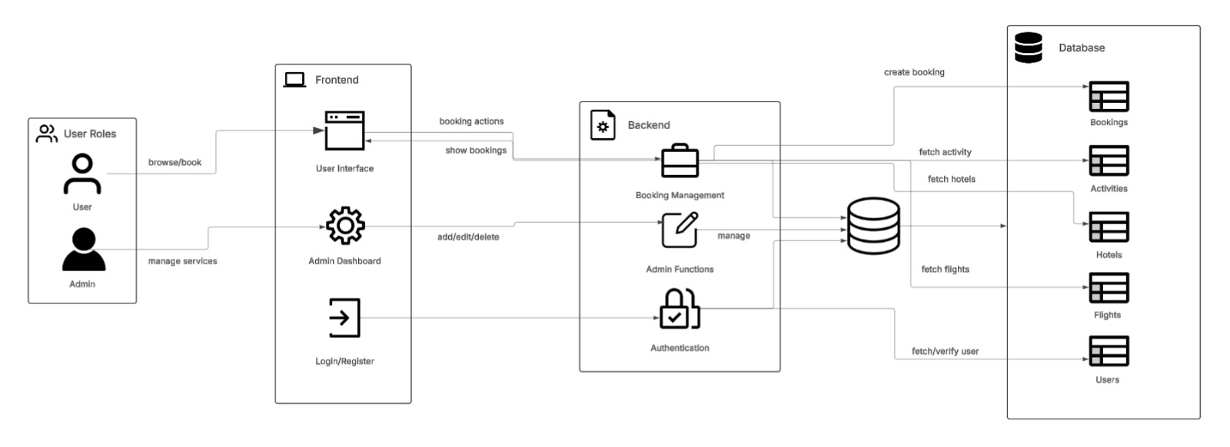
ARCHITECTURAL DESIGN FOR PROPOSED SYSTEM
Date Slide Number

Slide 10
ALGORITHM/ TECHNIQUE USED
Backend Development:
PHP is used to handle server-side operations, process user requests, and manage sessions securely.
Authentication Technique:
Role-based authentication system using PHP sessions to distinguish between normal users and admins.
Database Management:
MySQL relational database is used to store and manage user information, travel services, and bookings efficiently.
Frontend Development:
HTML, CSS, and Bootstrap are used for creating a responsive and user-friendly interface.
CRUD Operations (Create, Read, Update, Delete):
Admins perform CRUD operations on flights, hotels, and activities through a simple admin dashboard.
Security Measures:
Passwords are stored securely (e.g., using hashing techniques if implemented).
Session management to protect unauthorized access.
Date Slide Number

Slide 11
Results and Discussions
Successfully built a travel booking platform with user and admin roles.
Users can browse and book flights, hotels, and activities easily.
Admins can manage services (add, edit, delete) through a dashboard.
Secure login system with role-based access control.
Responsive design ensures usability across all devices.
Database efficiently manages users, bookings, and service data.
Future improvements: Payment integration and enhanced security.
Date Slide Number

Slide 12
ADVANTAGE OF PROPOSED SYSTEM
User-Friendly Interface: Simplifies browsing and booking for users.
Efficient Admin Management: Easy handling of flights, hotels, and activities.
Secure Access: Role-based authentication ensures data protection.
Centralized Database: Organized storage of users, services, and bookings.
Responsive Design: Accessible across desktops, tablets, and mobiles.
Faster Booking Process: Reduces time and complexity for users.
Scalable Platform: Can be easily expanded with future features.
Date Slide Number

Slide 13
Conclusion
The travel booking platform successfully integrates user-friendly and admin-friendly features.
Secure authentication and role-based access ensure data protection and proper access control.
The system provides a responsive design and efficient database management for seamless operation.
Future improvements like payment integration and enhanced security can further improve the system.
Date Slide Number

Slide 14
REFERENCES
[1] Junliang Lu, Xinli Wang and Zhanjing Xu, "Research on website e-service quality of scenic area: The perspective of customer satisfaction and behavior intention," 2012 International Conference on Information Management, Innovation Management and Industrial Engineering, Sanya, 2012, pp. 205-208, doi: 10.1109/ICIII.2012.6339814.
[2] Qinghua Zhang, "Study on travel intermediaries in E-commerce environment," 2008 IEEE International Conference on Automation and Logistics, Qingdao, 2008, pp. 2094-2098, doi: 10.1109/ICAL.2008.4636509.
[3] D. Y. Yoon and Y. S. Jang, "A study on quality evaluation for travel agency's website," The 40th International Conference on Computers & Indutrial Engineering, Awaji, Japan, 2010, pp. 1-4, doi: 10.1109/ICCIE.2010.5668438.
[4] C. Haiyan, "An Impact of Social Media on Online Travel Information Search in China," 2010 3rd International Conference on Information Management, Innovation Management and Industrial Engineering, Kunming, China, 2010, pp. 509-512, doi: 10.1109/ICIII.2010.443.
[5] M. Conyette, "Modeling factors that influence online travel booking," Proceedings of the International Conference on e-Business, Seville, Spain, 2011, pp. 1-6
Date Slide Number

Slide 15
THANK YOU
Date Slide Number

